Slide 1
R Group Data import/export & cleaning Epi handbook Ch 7 & 8
Shaun Nielsen
19/05/2020

Slide 2
Data import and export
Chapter 7

Slide 3
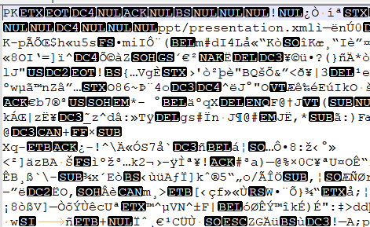
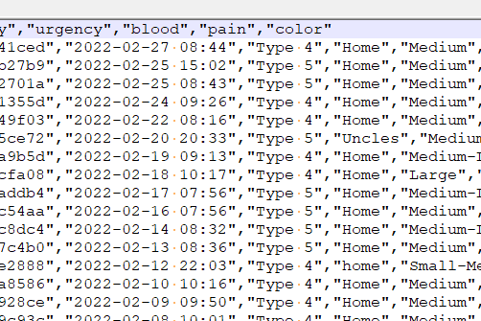
Data import and export (I/O)
R can import and export data from almost every file type and source
BUT why are there so many file types and how do they differ?
Short answer: computer vs human readable data …
Attribute | Computer | Human
File size | Smaller | Larger
Import/export speed | Faster | Slower
Can interpret in text editor? | No | Yes

Slide 4
Data import and export (I/O)
Broad data IO in R is achieved through various packages
Which does what? And what is best?
The Epi handbook recommends to the package rio … R I/O
Rio is flexibility imports and exports data based on file extension
linelist <- import("linelist_cleaned.csv")
linelist <- import("linelist_cleaned.xlsx")
linelist <- import("linelist_cleaned.sas7bdat")

Slide 5
Data import
There are specific options for file types, e.g
lines to skip
Excel worksheets
What missing values are … blank, “NA”, “Missing”
Can also import from online sources
Googlesheet, data APIs
Databases (not discussed in handbook)
linelist <- import("linelist_raw.xlsx", skip = 1)
linelist <- import("my_excel_file.xlsx", which = "Sheetname")
linelist <- import("data", "my_linelist.csv"), na = c("Missing", "", " "))

Slide 6
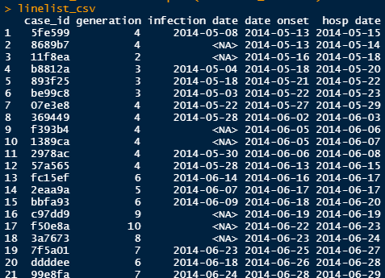
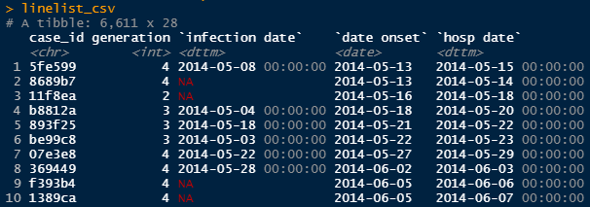
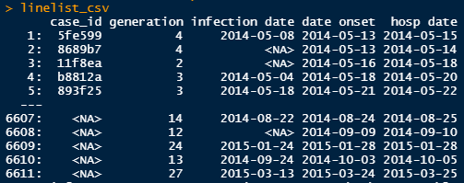
Data import and object class
(Minor) caution with import()
Import packages can set the class of the data.frame
Class is used to determine how R handles objects
What methods are used to do things – some faster than others!
e.g printing data.frames …
data.frame
tibble
data.table

Slide 7
Data export
Output format is dependent on task … who will use?
Good to export native R data files … will only R be used downstream?
Keep formats (factors, dates)
And make use of .Rdata, saving multiple objects into a single file
not using rio
export(linelist, “my_linelist.rds")
save(my_list, my_dataframe, my_vector, file = "my_objects.Rdata")

Slide 8
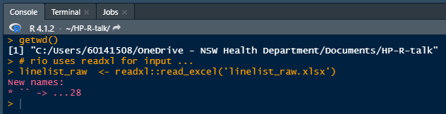
File paths
Often a headache for newbies
R has a working directory … getwd()
Be careful of file paths
Especially when sharing analyses
Use of projects and the here package
Windows files paths have \ and R uses /

Slide 9
Data cleaning
Chapter 8

Slide 10
Data cleaning
You want to ensure data is correct before conducting major analyses
we ‘clean’ our data to achieve this
What is clean?
interpretable and consistent column names
column types correct … dates are dates, ages are numbers, etc
categories are correct … spelling errors fixed, groups corrects
unnecessary columns removed
derived/additional columns included
unnecessary rows removed

Slide 11
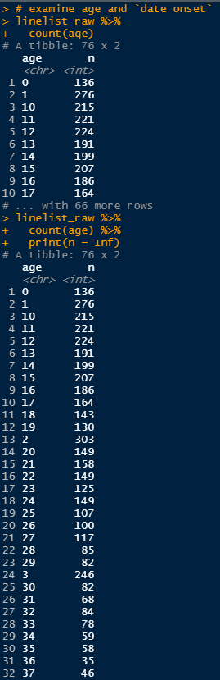
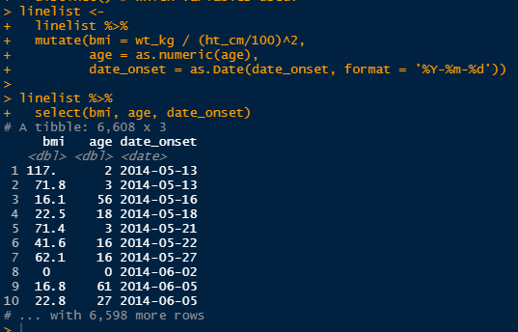
Data cleaning tips
Age imported as character,
can scan values quickly here
Always check things both before and after
simply print to the console (be mindful of length … use count())
tibble data.frame have good printing options

